Slide 1
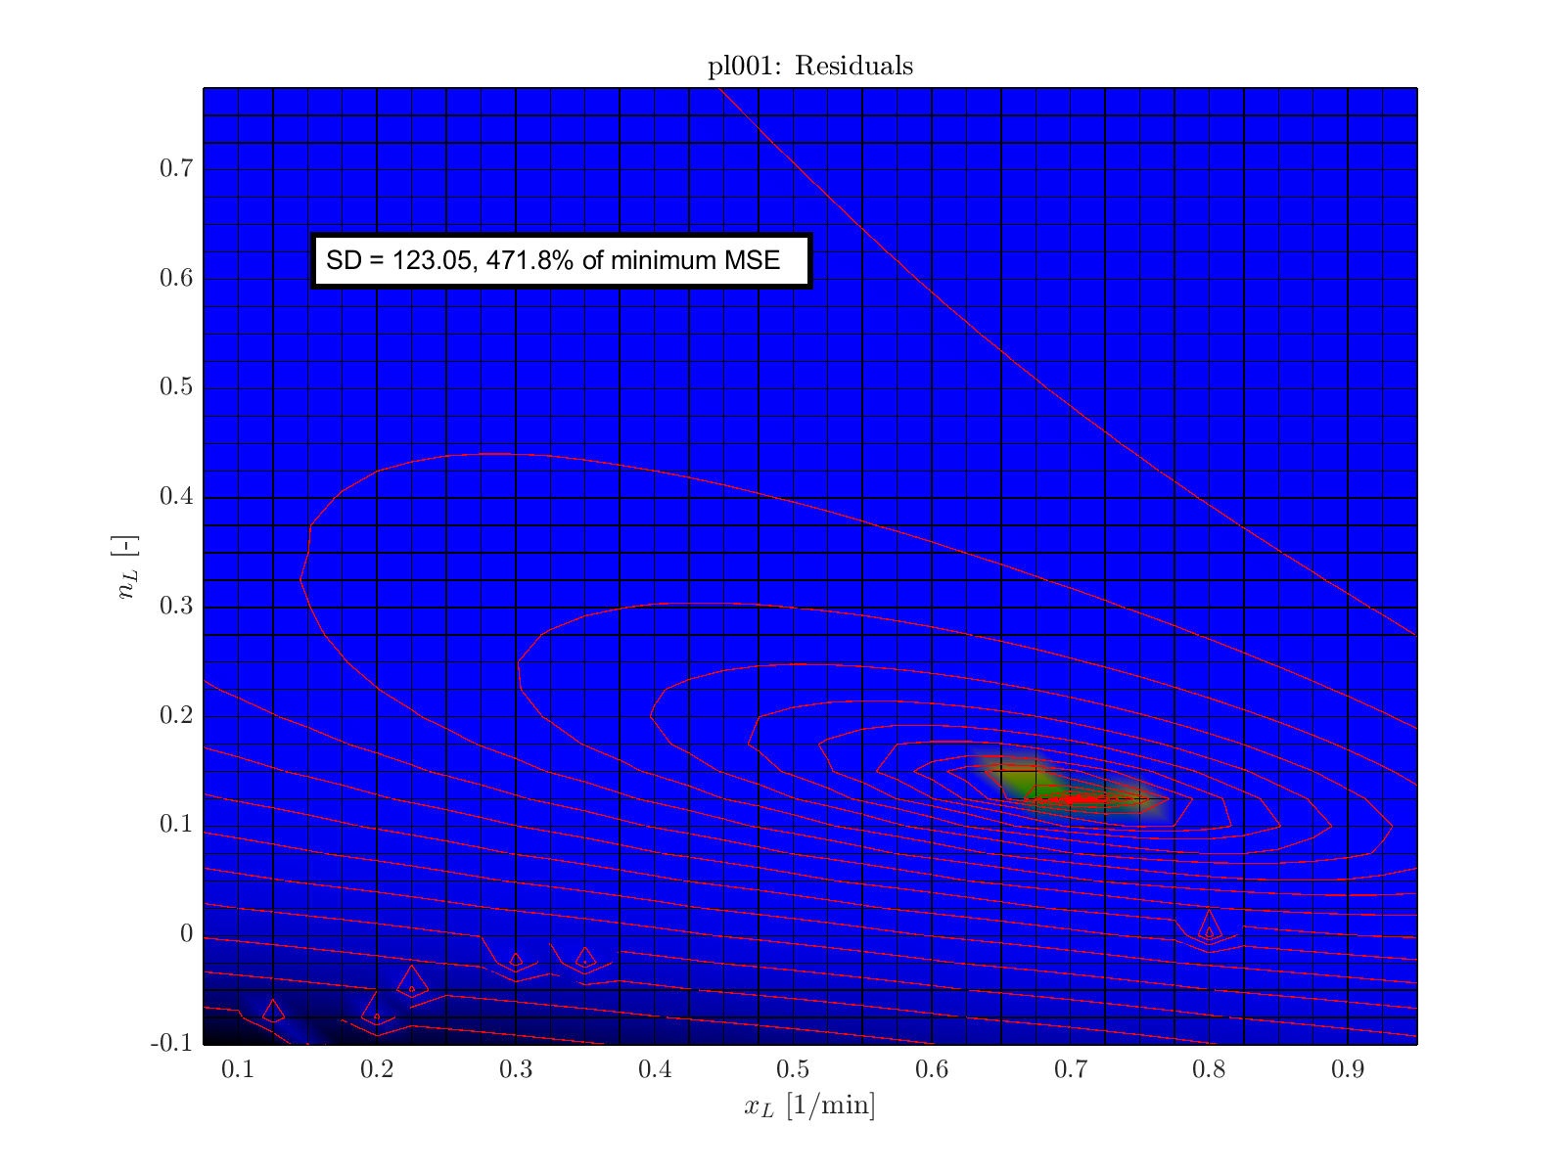
pl001
Male
BMI < 25

Slide 2

cp008
Male
BMI < 25

Slide 3
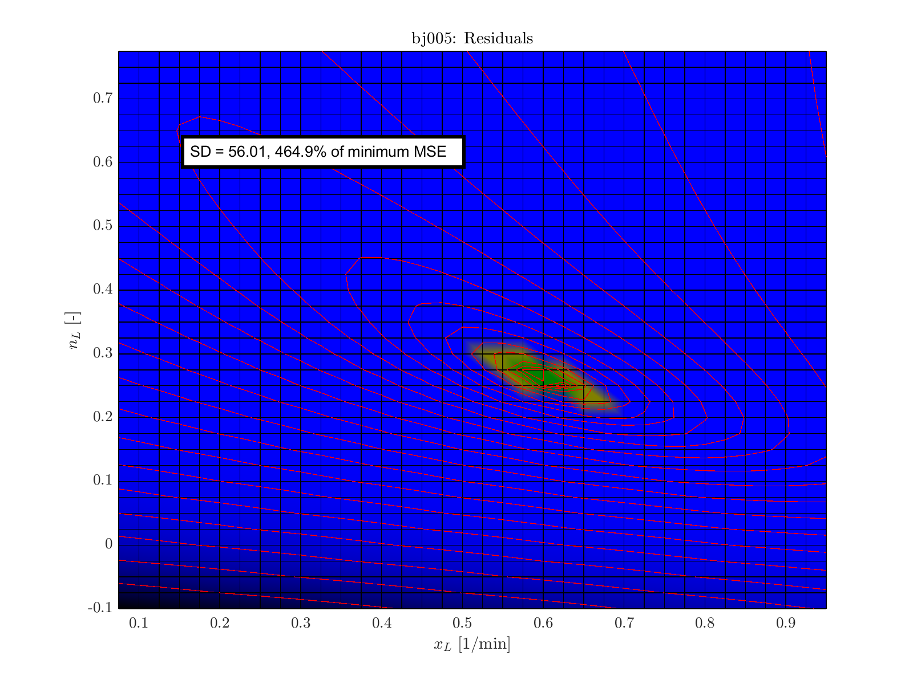
bj005
Female
BMI < 25

Slide 4

mh007
Female
BMI < 25

Slide 5
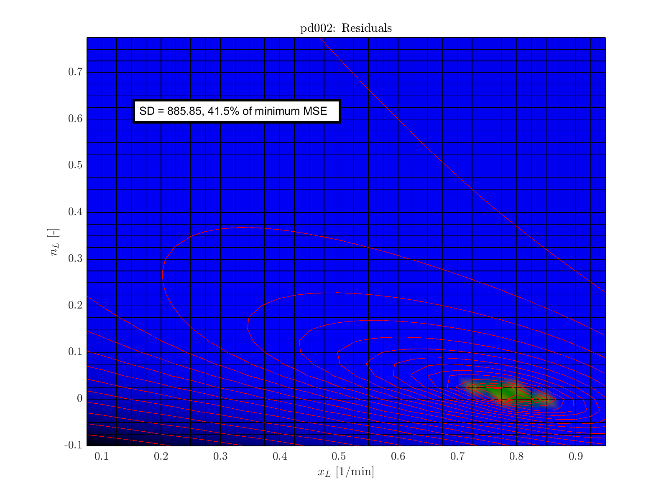
pd002
Male
25 <= BMI < 30

Slide 6
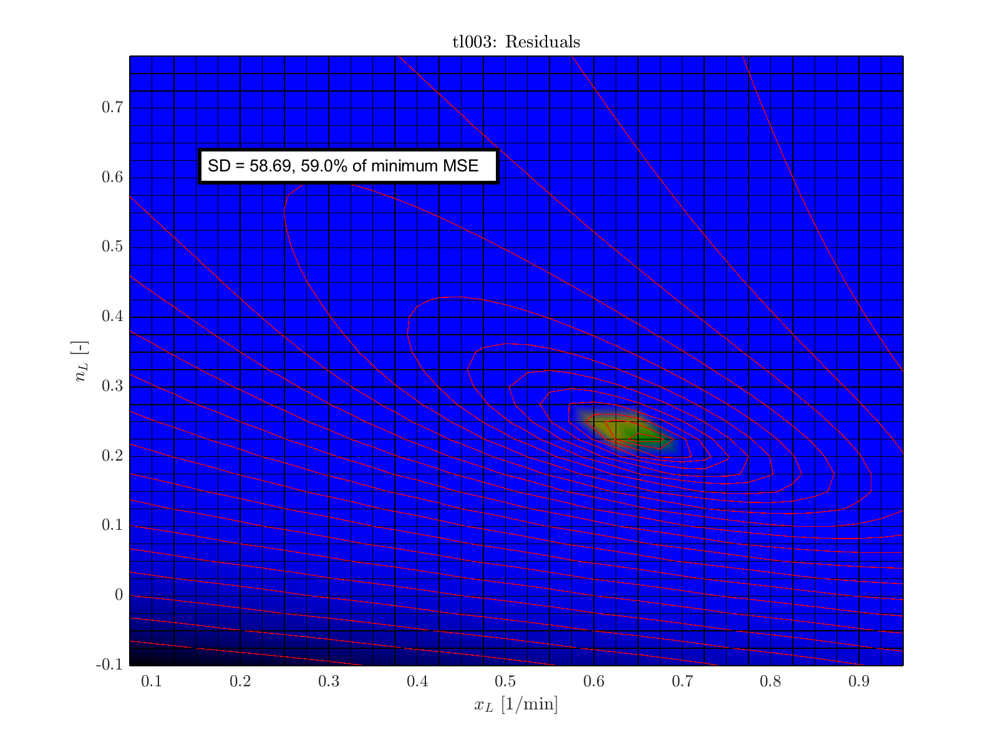
tl003
Male
25 <= BMI < 30

Slide 7
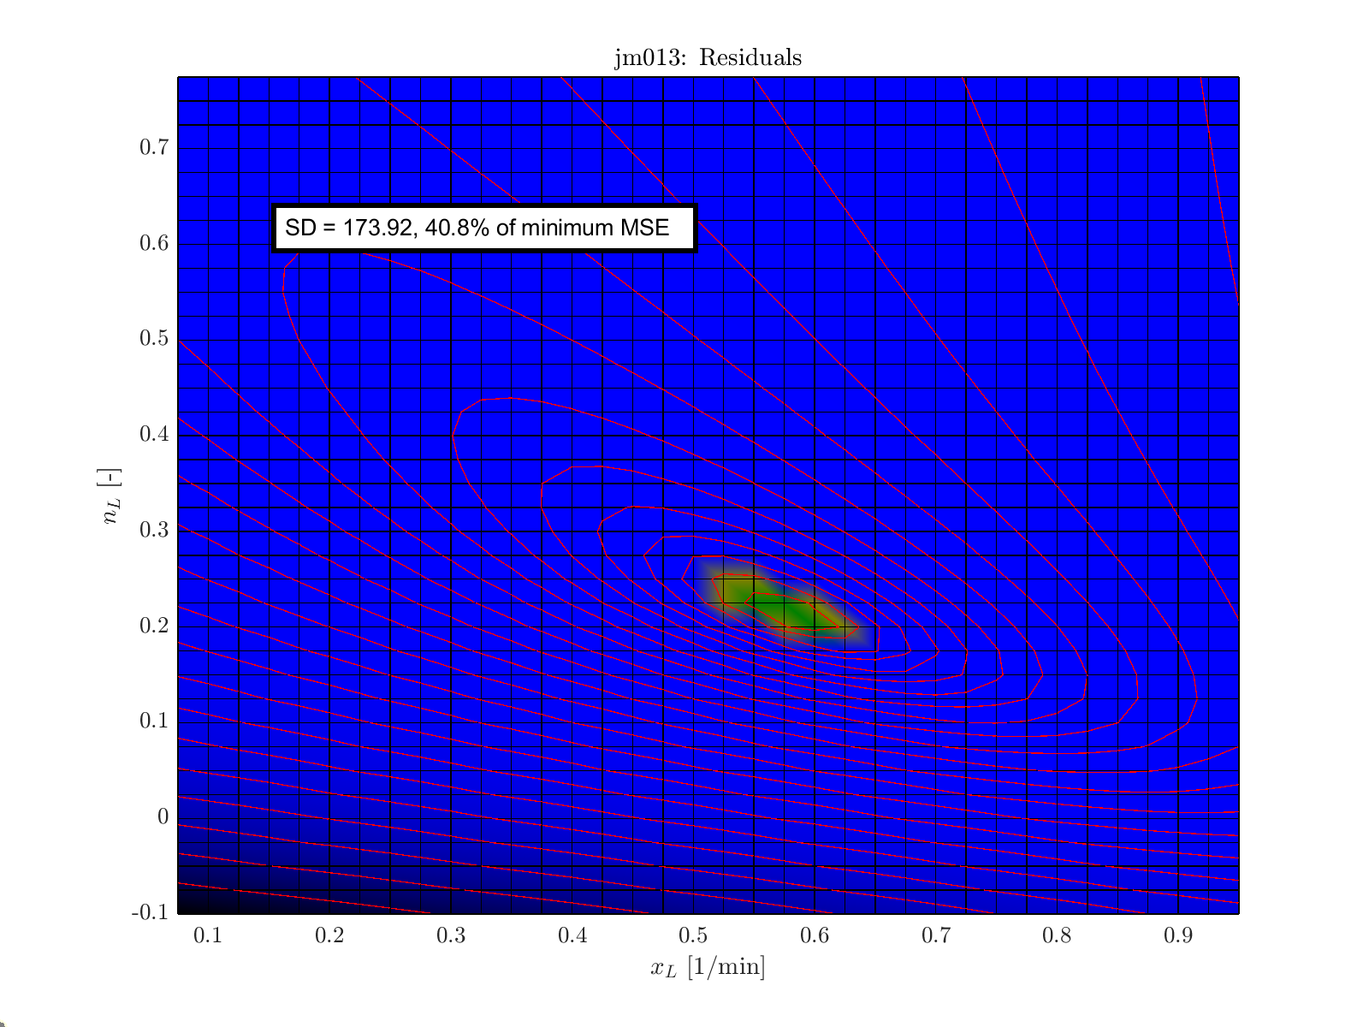
jm013
Male
25 <= BMI < 30

Slide 8
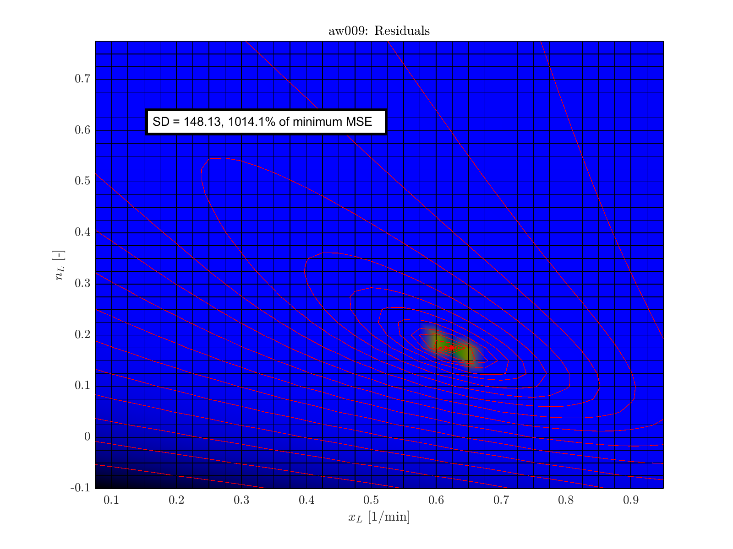
aw009
Female
25 <= BMI < 30

Slide 9
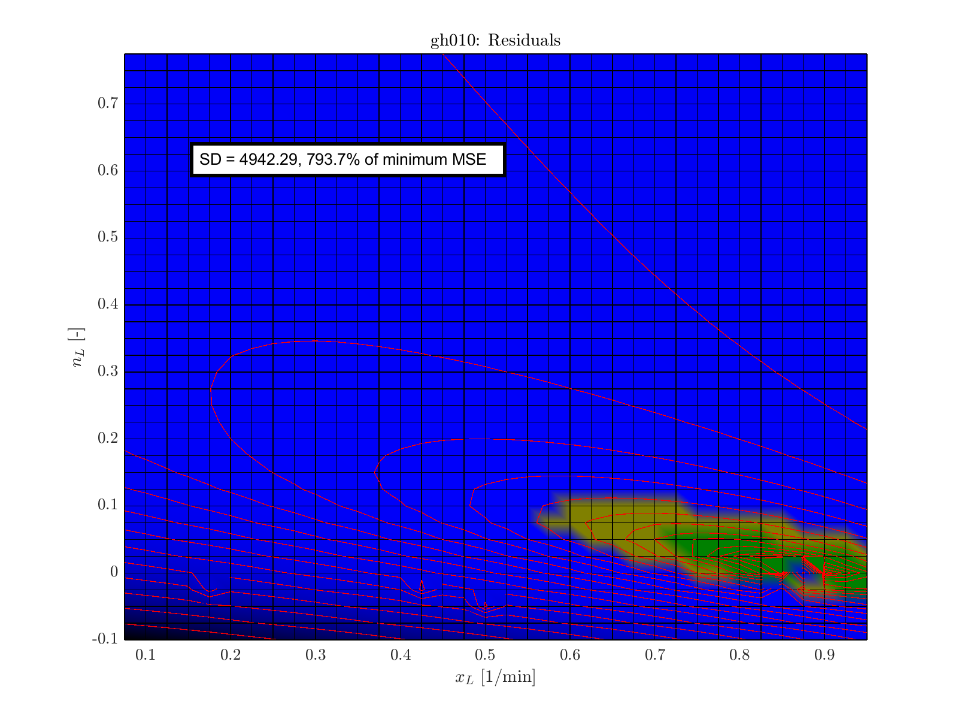
gh010
Female
25 <= BMI < 30

Slide 10

pp024
Female
25 <= BMI < 30

